Slide 1
Kimmo Rossi
Head of R&I sector
European Commission
DG CONNECT Unit G.3 - Data Value Chain
KITES Symposium 31/10/2013

Slide 2
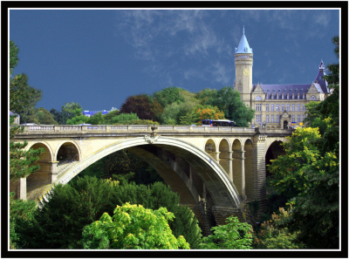
EUROPEAN COMMISSION
The Communication Networks, Content & Technology Directorate General (DG CONNECT)
Directorate G - Media and Data
G1: Converging Media and Content
G2: Creativity
G3: Data Value Chain
G4: Inclusion, Skills and Youth
G5: Administration and Finance

Slide 3
Who are we?
Unit CNECT.G3 – Data Value Chain
Resulted from merging three units in July 2012:
Language technologies (language data, analytics)
Information management (big data, linked data, analytics)
Public sector information (open data)
We manage a portfolio of 130 R&I projects with 300+ MEUR EU funding, 1500 FTE
Responsible for: European Data value chain strategy, open data strategy and the PSI directive

Slide 4
Definitions
What is Open Data?
A useful definition: http://opendefinition.org/
free of charge (or almost)
free to use, re-use, distribute
...for any purpose (also commercially)
can be public OD (government) or private OD (user-generated, corporate)
must not violate privacy
www.open-data.europa.eu (EU OD portal)
http://publicdata.eu (the LOD2 project)

Slide 5
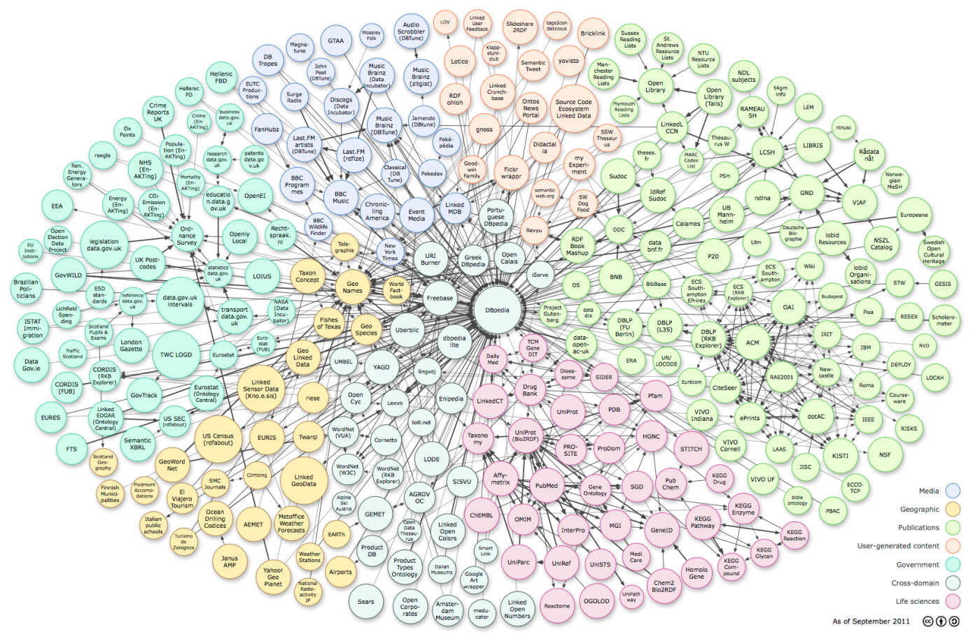
Definitions
What is Linked Data?
Linking Open Data cloud diagram, by Richard Cyganiak and Anja Jentzsch. http://lod-cloud.net/

Slide 6
Definitions
What is Linked Data?
Allows access to Web content as a database – very useful!
But there are problems:
What merits to be linked?
How to establish links?
How to ensure quality of (automatically established) links?
Currently very scarce and English-dominated
For details, see LOD2 project: http://lod2.eu

Slide 7
Definitions
What is Big Data?
Very difficult to define...
data is "big" if it defies traditional processing & storage paradigms – bigness becomes part of the problem
the "3Vs": volume (size), velocity (bytes/s), variety (database, jpeg, video, numbers, text in language X...)
...to which we add the 4th V to denote creation of Value (by linking, aggregating, analysing, visualizing...)
"linguistic" big data: all tweets, all news broadcasts, YouTube contents...
statistical MT is powered (trained) by big data – but can it handle big data?

Slide 8
European Data value chain strategy
Objective: to put in place the "systemic" prerequisites for effective use, exchange, re-use, trading... of data assets
capacities and skills: build and multiply the "new" competences, curricula, prize/recognition schemes
infrastructures: Open Data Portal, language resource infrastructure, evaluation platforms, incubators
legal and regulatory framework: PSI directive (Public Open Data), data protection and privacy, copyright
technology, tools, methods: supporting the above
pilots, demonstrators: demonstrating the above in real-world problem settings, market validation

Slide 9
Instruments
Making it happen
Research and innovation: Horizon 2020 – the Research & Innovation funding programme for 2014-2020
Big Data analytics, prediction, MT: cross-language and cross-sectoral (industrial) validation, capacity-building
Deployment and service infrastructures: Connecting Europe Facility (CEF), addressing, for example:
Open Data Portal, Automated translation, language resources & tools repository
Policy and regulation: PSI directive, privacy, copyright
Support creation of Data market, remove obstacles from re-use of valuable data

Slide 10
Projects
Some ongoing and emerging initiatives
META-SHARE: language resources repository and sharing infrastructure www.meta-share.eu
MT training and deployment pilots: MT@EC, iTranslate4.eu, LetsMT!, Bologna...
MosesCore: making most out of MOSES www.mosescore.eu
MultilingualWeb: standards and workflows for language processing www.multilingualweb.eu
FALCON: Linked (Open) Data for localisation, MT and term extraction, LIDER: Linked Data as enabler of cross-media and multilingual content analytics
LT Innovate: networking the language industry www.lt-innovate.eu

Slide 11
MT@EC
MT@EC
The internal Machine Translation project of Commission's DG Translation
Aim: to provide functional MT service for EU institutions and (later), MS administrations, pan-EU online services
Currently based on MOSES open source technology (but open to other solutions as plug-in)
In pilot use since summer 2011 (EC)
In production since June 2013 (EU institutions)
Already 8 million pages translated
Very good quality for some language pairs

Slide 12
Coming up 2014-2020
On the next slides, I will present topics of interest from the current state of:
Horizon 2020
Connecting Europe Facility
Disclaimer: the programmes described in the next slides are at the level of proposal/draft and subject to change following a multi-party adoption process. Only the versions formally adopted by the legislative bodies can be considered final and binding.

Slide 13
Connecting Europe Facility (CEF)

Slide 14
CEF – Overview
What is CEF?
A funding programme for infrastructures and deployment of digital services
procurement and deployment of mature technology to build a "core platform"
grants for "generic services" building on and linking to core platform
Includes a small number of "building blocks" (e.g. document delivery, eInvoicing, eID, Automated translation)
What CEF is not?
research or innovation (Horizon 2020 is for that)
How much?
1 B€ in total for the "Telecommunications" title (Broadband & Digital services)

Slide 15
CEF – Automated Translation (AT)
Rationale
Automated Translation (AT) is a "building block"
AT will serve the other Digital Services Infrastructures in CEF
AT = whatever it takes to make DSIs actually multilingual
Features
Adaptable machine translation and relevant Language Resources are central
Other likely key areas: CAT, CMS, terminology, semantic interoperability, interfaces to various systems and data types
Human element is essential: service provision, quality control, validation, post-editing, on-demand response...
Instruments: mostly procurement (calls for tender)
National dimension: CEF implies and encourages partnerships with member states and regions, e.g. use of structural funds for language resources and, technology and translation on a "local" basis

Slide 16
CEF – stakeholders, contributors
Language industry
providers of language technology, especially MT
language service providers
Language competence centres: provision of language resources, tools, validation and evaluation
Member states/regions: coordinating local/national/regional programs and initiatives with CEF to reach critical mass

Slide 17
Horizon 2020 – the Research and Innovation programme

Slide 18
H2020 Work Programme 2014-15
DRAFT!
Some topics:
Big Data & Open data - Innovation – 50 M€
Big Data – Research – 39 M€
Cracking the language barrier – 15 M€
Multimodal & natural interaction – 7.5 M€

Slide 19
Big Data - Rationale
DRAFT!
(Big/Smart/Open) Data represents significant potential for job creation and wealth (revenue) generation
European Data landscape is fragmented
data producers: public sector, private sector, sensors, devices, transactions...
data industry: a few large companies, high number of SMEs
language barriers, legal & institutional obstacles
data users: practically all industry sectors
We need to create European Data ecosystem, where
data flows without unnecessary obstacles (open data, interoperability)
data creates value (by analysing, linking, visualizing...)
data and the added value is accessible to all actors
we have appropriate capacities for value creation (skills, infrastructures, markets, technology)

Slide 20
Big Data – How
DRAFT!
Improve EU capacities, develop generic technology and address entire data value chains and markets - cross-sector, cross-border, cross-language
1. Innovation actions: promote open data value chains and data markets, involve SMEs, technology transfer and data exchange/reuse in cross-sector/cross-border settings, network of European skills centres for big data analytics technologies and business development
2. Research actions: novel data structures, algorithms, architectures, optimization and language understanding technologies etc. for analysis and visualisation tasks on extremely large and diverse data streams; competitions/prize schemes around specific big data challenges (e.g. prediction, deep analysis) arising from key industrial domains (e.g. geo-spatial, energy, finance, health, skills/employment, agriculture, climate/weather, product recommendations...)
Implies: strong attention to application areas: building the (sub)communities and links to sector-specific Societal Challenges

Slide 21
Big Data – What
DRAFT!
Innovation (50 M€, Call 1)
1. Open Data reuse incubator for SMEs: spin off mini projects building experiments and proofs-of-concept for business models and value-adding chains based on reuse of Open Data.
2. Collaborative projects on cross-sectoral, cross-border, cross-lingual analytics solutions/services, technology transfer, market validation, clear business cases.
3. Horizontal actions:
Cross-program coordination on Big Data
Network of skills centres, curricula, training and education
Networking, clustering, legal issues etc.
Research (39 M€, Call 2)
1. Collaborative projects addressing analysis, prediction, visualization on extremely large, diverse (multilingual, structured/unstructured) data
2. Collaborative projects to set up benchmarking and evaluation settings for big data analysis and prediction
3. Prize schemes to stimulate excellence in deep analysis and prediction on Big Data

Slide 22
Cracking the language barrier
DRAFT!
Problem: European Digital Single Market is fragmented by language barriers. Current (e.g. Google) machine translation solutions fall short in quality and coverage (languages, text types, topics) and are not customizable. Lack of cross-lingual technology equally hampers progress in multi- and cross-lingual analytics
Solution: explore new avenues, methods, approaches to achieve significant improvement in translation quality in fully automatic MT. Special emphasis on: all (difficult, small) EU languages as target language. Self-learning/self-improving systems, making best use of available data and language resources. Special focus on the EU languages "facing digital extinction".
Implications: close collaboration and clustering with other actions supporting language resources infrastructure (META, Connecting Europe Facility, national programs, structural funds)

Slide 23
Cracking the language barrier – How
DRAFT!
Approach: explore new avenues, methods, approaches to achieve significant improvement in translation quality in MT.
Self-learning/self-improving autonomous, fully automatic systems, making best use of available data and language resources.
Emphasis on: all (difficult, small) EU languages as target language. Special focus on the EU languages "facing digital extinction".
Implications:
close collaboration and clustering among all actions supporting a language infrastructure (META, CLARIN-ERIC, Connecting Europe Facility, national programs, structural funds...)

Slide 24
Cracking the language barrier – What
DRAFT!
Cracking the language barrier (15M€, Call 1)
One deep and broad research project
kick off a multidisciplinary research action
focus on points where current systems fail (adaptation, quality, need of large corpora...)
break the glass ceiling of quality improvement
A few advanced pilots – the "intertwined innovation" element
test, validate, evaluate quality improvement in realistic use situations, e.g. online services
address "poorly served" languages
connect, contribute & make use of platforms and infrastructures for language resources, open data...
One Coordination Action: promote a common language resources infrastructure for MT, benchmarking, best practices evaluation, interoperability, metadata harmonisation...

Slide 25
Multimodal & Natural human-computer interaction
DRAFT!
Rationale: while systems and devices are becoming more and more powerful, the interface to humans is lagging behind
Objective: achieve transparency and invisibility of technology – effortless, effective human-machine dialogue, easy use of complex and powerful systems, easy access to information
Links to: creative industries, communication technologies, language (especially: speech) processing, cognitive & behavioural analysis
Uses: search, information retrieval, elderly, people with special needs, designers/artists...

Slide 26
Events
ICT 2013 Conference in Vilnius 6-8 Nov 2013
http://ec.europa.eu/digital-agenda/en/ict-2013
In-depth presentations of Horizon 2020 Work Programme 2014-15
Networking sessions
Plenary session on Big Data with VP Neelie Kroes
Info Day in Luxembourg 15-16 January 2014
In-depth presentations of Horizon 2020 Work Programme 2014-15
Proposal clinics
Networking sessions – partner matching – present your proposal idea
First announcement online, agenda will follow soon: https://ec.europa.eu/digital-agenda/en/news/information-and-networking-days-data-value-chain-and-language-technologies

Slide 27
Thank you! kimmo.rossi@ec.europa.eu http://cordis.europa.eu/info-management http://cordis.europa.eu/fp7/ict/language-technologies/

