Slide 1
TRENDS IN THE LANGUAGE INDUSTRY

Slide 2
@amclind
#Kites2013

Slide 3
A LIFETIME OF JOY AND EMPLOYMENT
VOLUME INCREASE
TECHNOLOGY AS A PRODUCTIVITY ENHANCER
DISINTERMEDIATION

Slide 4
MORE CONTENT HAS BEEN CREATED IN THE LAST DECADE THAN IN ALL OF THE HISTORY OF MANKIND
ACCESS TO INFORMATION HAS NEVER BEEN EASIER.

Slide 5
GLOBALIZATION
GLOBALIZATION DRIVES NEED FOR LOCAL LANGUAGE
NATIVE LANGUAGE – FUNDAMENTAL HUMAN RIGHT
LANGUAGE AS A DIFFERENTIATOR
CHEAPEST PART OF SUCCESFUL GLOBALIZATION IS TRANSLATION

Slide 6
VOLUME INCREASE
FAST SPEED INCREASE OF VOLUME
TRANSLATION RESOURCES ARE SCARCE
LIMITED RESOURCES DRIVES NEED FOR TECHNOLOGY AND AUTOMATION
MACHINE TRANSLATION DRIVES NEED FOR HUMAN TRANSLATION
“THE RISING TIDE LIFTS ALL BOATS”

Slide 8
TECHNOLOGY
CONTENT HAS EXPLODED
CAN’T STOP THE DEVELOPMENT OF TECHNOLOGY
USE IT TO YOUR ADVANTAGE
TECHNOLOGY IS AN ENABLER
”

Slide 9
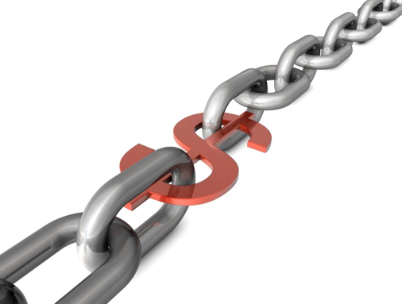
DISINTERMEDIATION
disintermediation is the removal of intermediaries in a supply chain, or "cutting out the middleman”

Slide 10
WAY TO SUCCESS
DOMAIN OF SPECIALIZATION
TRANSLATE WHAT YOU LOVE
BECOME THE EXPERT
EMBRACE TECHNOLOGY
BUILD A COMMUNITY
COLLABORATE
EQUAL BEFORE DIFFERENT

Slide 11
SUMMARY

Slide 12
ThanK you FOR your attention!
Anne-Marie Colliander Lind
E-mail: anne-marie@inkrea.se
Twitter: @amclind
Web: www.inkrea.se
Blog: www.lioness.se
This presentation is partly built on my contribution to the book “Diversification in the Language Industry” by Nicole Y. Adams, coming in Nov 2013.

