Slide 1
THE ROLE OF Language service providers in A CHANGING INDUSTRY
KITES – Helsinki, 30.11.2013

Slide 2
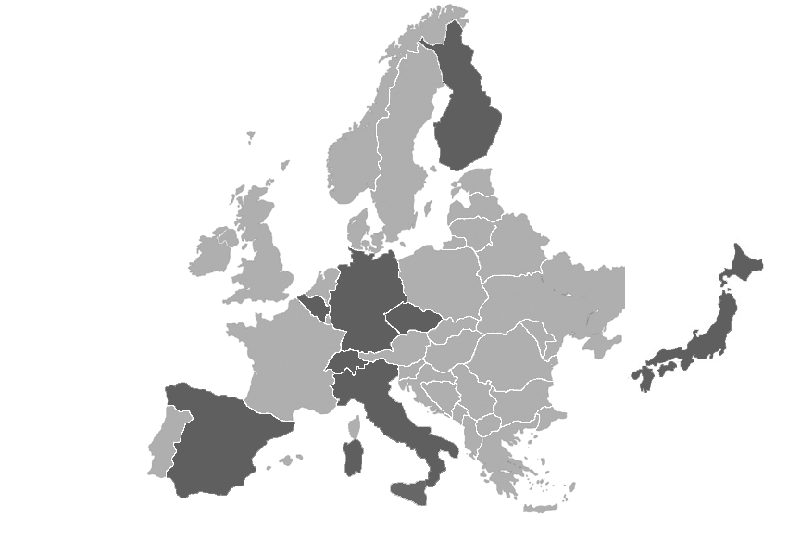
The Arancho Doc Group
Founded in 2011, the Arancho Doc Group is the result of a merger between two companies (Ic.Doc and Arancho) with a combined experience of over 30 years
10 offices in 8 countries (Belgium, Czech Republic, Finland, Germany, Italy, Japan, Spain, Switzerland)
More than 200 language combinations regularly managed
Almost 2,000 professional and specialized translators and proofreaders worldwide
Over 100 in-house language, IT and DTP professionals
Over 300,000 words managed and delivered every day
EN 15038 certification in Italy, Spain and Finland. SAP certified for Italy and Finland

Slide 3
About Myself
Born in Italy, resident of Finland since 1989
Degree in Economics in 2000 from University of Helsinki
Studies in languages, statistics and management
Worked as an IT and ERP consultant
In the T&L business since 1996
At Arancho Doc since 2012, member Executive Management Team
Currently focusing on competences and resources for the whole supply chain
Special emphasis on inter-company practices and the elimination of internal micro-optimization

Slide 4
FOCUS ON
Current state of the industry
Major trends
What do these mean to LSPs ?
Food for thoughts

Slide 5
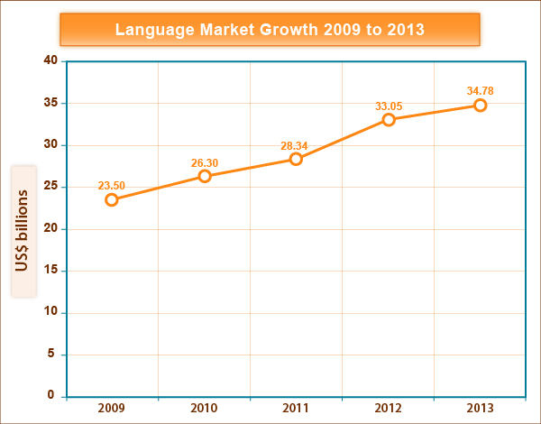
Where do we stand today
The market for Language services in 2013 will total to 26.1 bil. €
Annual growth rate
of 5.13%
In spite of increase in
volumes, prices dwindle
Market for PEMT is
worth 630 mil. €
44% of LSPs offer PEMT
or related services

Slide 6
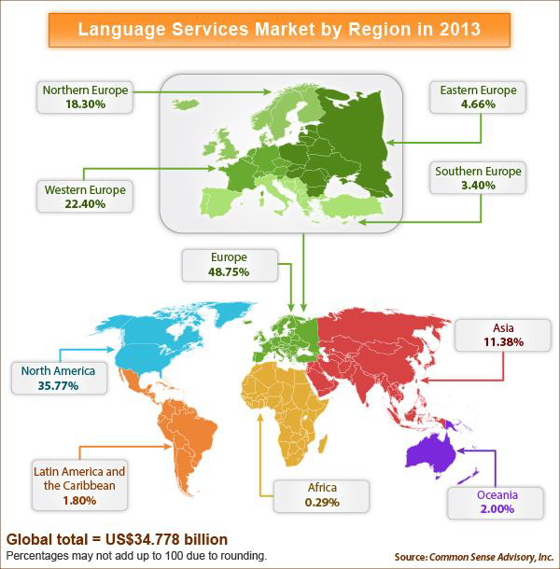

Slide 7
Percentage of LSPs in the Region
 |  | 2011 | 2012 | 2012
Africa |  | 1.90 | 1.86 | 1.89
Asia |  | 14.70 | 15.78 | 14.76
Europe |  | 58.07 | 55.36 | 57.83
 | Eastern | 14.00 | 14.84 | 13.96
 | Northern | 14.92 | 15.78 | 14.92
 | Southern | 11.44 | 6.12 | 11.52
 | Western | 17.71 | 18.62 | 17.44
Latin America |  | 4.91 | 5.17 | 5.30
North America |  | 18.38 | 19.57 | 18.31
Oceania |  | 2.10 | 2.15 | 1.92

Slide 8
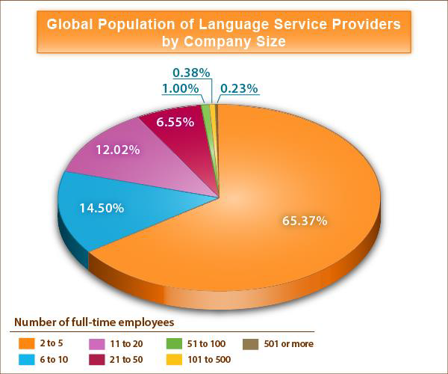

Slide 9
Revenue per Employee by Company Size in 2011/2012
Number of Full-Time Employees | Average Revenue per Employee in US$
2 to 5 | 82,103
6 to 10 | 114,535
11 to 20 | 115,003
21 to 50 | 103,369
51 to 100 | 105,906
101 to 500 | 98,695
501 or more | 79,842

Slide 10
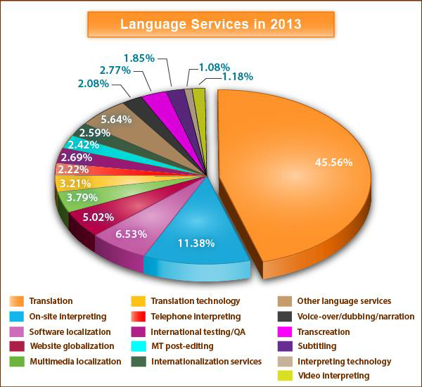

Slide 11
Major trends
Commoditization
Price pressure
Micro-translations
Machine translation

Slide 12
Translation as a commodity - 1
Commoditization: process by which goods that have economic value and are distinguishable in terms of attributes (uniqueness or brand) end up becoming simple commodities in the eyes of the market or consumers
Merriam-Webster again defines a commodity as “a mass-produced unspecialized product.” Wikipedia specifies that “It is used to describe a class of goods for which there is demand, but which is supplied without qualitative differentiation across a market. A commodity has full or partial fungibility; that is, the market treats its instances as equivalent or nearly so with no regard to who produced them.”

Slide 13
Translation as a commodity - 2
Translation is the typical product or service of which the purchaser cannot foretell the quality
Translation purchasers always see it as a COST
Commodification is a consequence on downward pricing pressures, which are caused by an undifferentiated offer, since when customers perceive no difference in products/services, they will make price a differentiator.
In competitive, undifferentiated markets with little o none barrier-to-entry, prices will generally be lowered by competitors down to be just above the marginal cost.
Resellers have no choice but to wipe out as many costs as they can to bring their price as close to zero as they can.

Slide 14
Translation as a commodity - 3
In addition, when the main product is bought and sold rather than produced, costs cannot be cut beyond the point where price gets as close to zero as it can get away with.
to cut costs to survive when facing increasing price competition, LSP have two choices:
Increase productivity by streamlining processes.
Take advantage of a market where information asymmetry is the rule rather than the exception
LSP’s are too often playing as middleman
This becomes an industry with near-to-zero marginal-cost products and services, thus inherently unstable

Slide 15
Price pressure depresses earnings
Steep decline in per-word rates since 2004
This drop is due to a combination of external forces
the economy
Immigration
workforce globalization
professional purchasing
as well as intrinsic industry factors
increased translation automation
the acceptance of lower quality levels
the elimination of process steps
self-commoditization

Slide 16
Microtranslations
Customers perceive jobs they send LSPs as a continuous engagement that doesn’t really fit the classical model, where each assignment is a separate entity. All tasks relate to a long term program, which – in turn – should be scalable to each single professional
Project size is getting smaller
TOT are shortening
Heads-up almost to zero
No minimum prices

Slide 17
Machine Transaltion
It is not about quality, rather about quantity
BIG DATA Paradox
A big company produces 20 Terabyte of data per day
An average transaltor produces 17.5 kilobytes of text per day
80% of the world’s content is unstructured
No more empty segments
Effort measurability, Productivity, Quality and Pricing
Post-Editing resources
”If you are not going to offer MTEP, your competitors will”

Slide 18
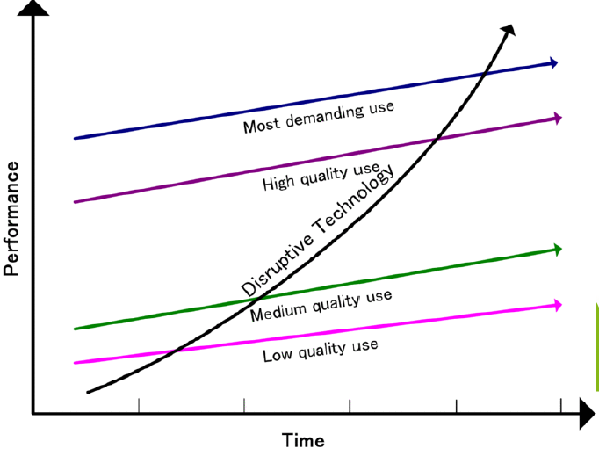
Disruptive innovation / technology
It is an innovation that helps create a new market and
value network, and
eventually goes on
to disrupt an existing market and value
network, displacing
an earlier
technology.
- Clayton M. Christensen

Slide 19
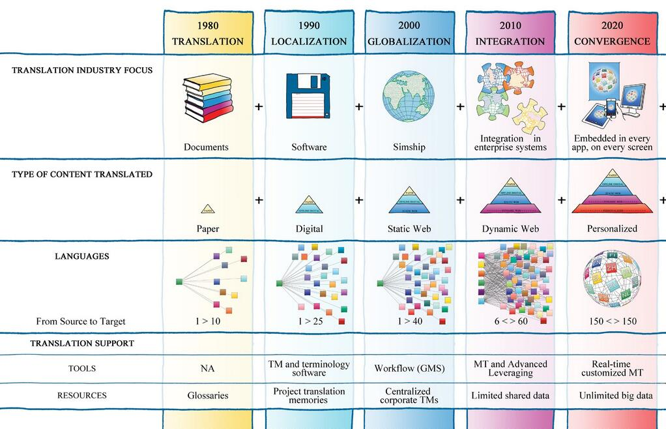
The future is here

Slide 20
What does all this mean to LSPs
Specialization vs Generalization
The bigger will get bigger, the smaller will get regional
Differenciate - Branding
Invest
in people
In the supply chain
in clients
in technology and improved efficiency
Provide solutions
Creative pricing

Slide 21
We have a database of 3000 translators
Company
Turnover
1 mil. €
Wordprice
0.10 €
# of words
10 mil.
Translator needed
10.000.000/600.000 =
17 !!
Translator
Output
2500 words /day
Working days
240
Year Output
600.000

Slide 22
Branding
Building a recognizable and successful brand requires customer satisfaction and loyalty, which outcome in longstanding client relationships, which help networking, which ends up in status, which eventually helps a branding model effective. This makes any brand an intangible asset, and yet a business’s most valuable one.
1) DO Market Yourself As a Business
2) DON'T Blather On About Your Amazing Capabilities
3) DO Start Designing Your Name, Brand & Logo -> Create a Story
4) Don't Be Inflexible
5) DO Become Fluent in Social Media

Slide 23
Invest in people
According to Common Sense Advisory, there are not enough good people in the translation industry. So, who can win translation industry sales?
Project managers: clients choose LSPs over freelancers because of the added value they bring
The translation industry is a people industry, and a winning branding strategy consists also of hiring the brightest people. Not pretending, not just claiming: Hiring
Hiring, though, is not enough. In a people industry, people are the most valuable assets, and must be motivated and retained. To retain staff, especially good staff a solid HR-strategy is paramount
(Tetra-ModelTM, an HR-model aimed at achieving a competitive and motivated workforce)

Slide 24
Invest in the Supply Chain We have a database of 3000 translators - Part 2
Number of translator needed: 17
Question 3:
Why should we care?
Impossible?
Question 2:
Why 17 better than 3000?
Question 1:
How do we get closer to 17?

Slide 25
Invest in the Supply Chain We have a database of 3000 translators - Part 2
Question 1:
How do we get closer to 17 ?
Specialization and focus on giver customers, verticals and markets
Account Management: grow clients to keep translators busy
Invest in Vendor Relationship Management
Be desirable: make transaltors want working for you

Slide 26
Invest in the Supply Chain We have a database of 3000 translators - Part 2
Question 2:
Why 17 better than 3000?
Easier to manage
Better control over availability
Better control of quality
Better relationships

Slide 27
Invest in the Supply Chain We have a database of 3000 translators - Part 2
Question 3:
Why should we care?
Everyone running an LSP should care, cause a well managed supply chain is at the core of her/his business efficiency and profitability

Slide 28
Invest in Clients
Good Account Management
Quality Matching
”This translation is no good” – ”I just need to understand what it reads”
Deadline Matching
Closing the ”Sales – Production” Gap

Slide 29
Invest in Technology
Translation business is a technology business
Embrace technology at all level: in order to gain in productivity, internal efficiency or provide added value to customers
Make you math: ROI
Automation of processes and repetitive activities
Facilitate people’s work: translators, project managers, managers, sales
Facilitate customers in approaching LSPs
Hire tech-savvy people

Slide 30
LSP’s as Solution Providers
Partner with experts
Sometimes partner with competitors
LSP as Content Curator:
Authoring->Transaltion->Management->Authoring
Staffing and personnel renting
Dare to talk with customers about their challenges

Slide 31
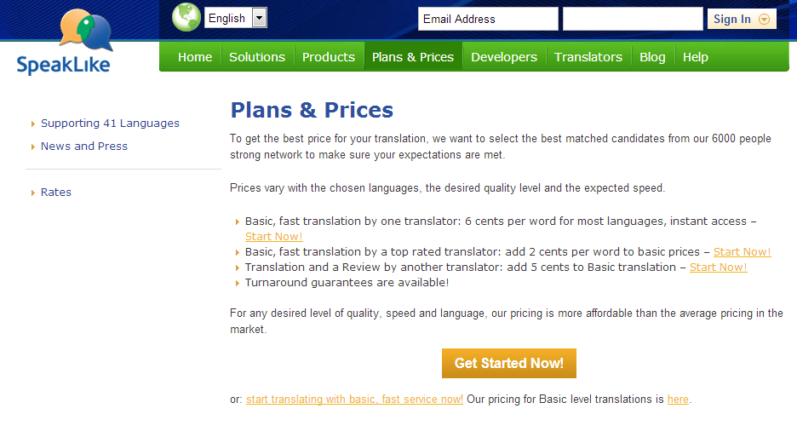
Creative Pricing

Slide 32
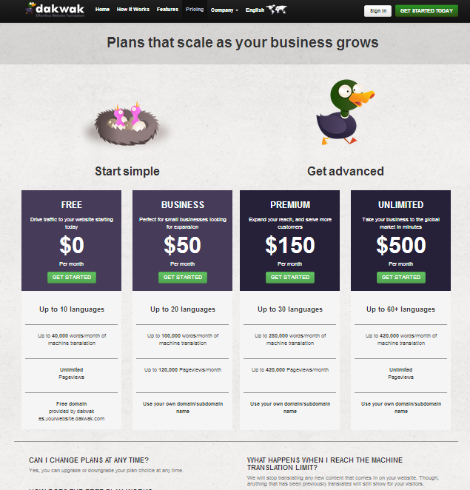
Creative Pricing

Slide 33
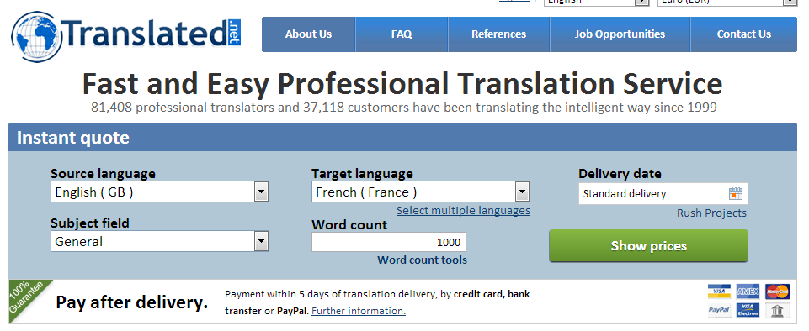
Creative Pricing

Slide 34
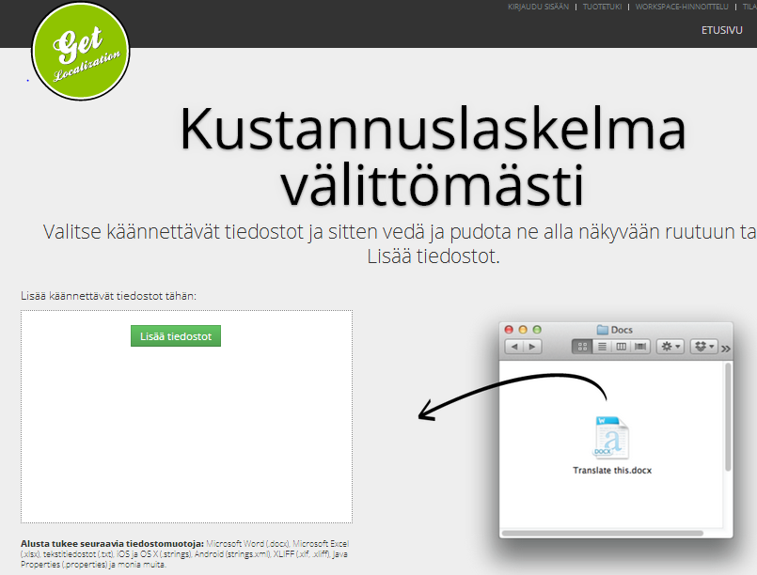
Creative Pricing

Slide 35
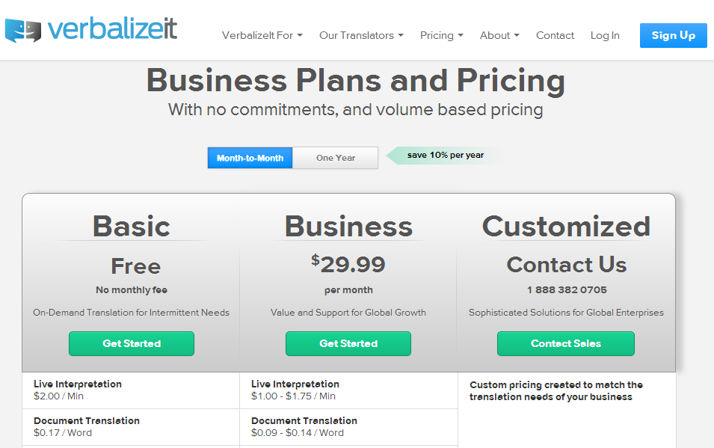
Creative Pricing

Slide 36
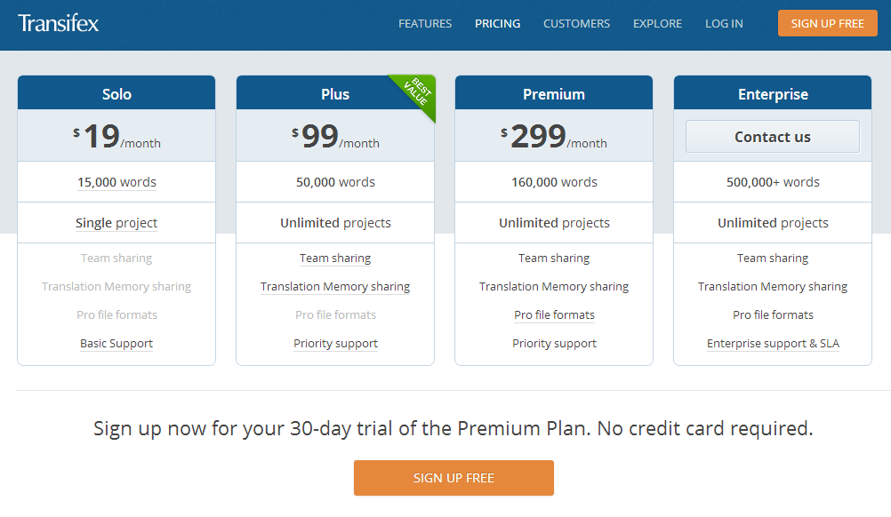
Creative Pricing

Slide 37
Creative Pricing

Slide 38
Creative Pricing – The Freebie Marketing
The freebie marketing model could maybe increase sales even in the translation industry, but a market for a good with cross elasticity of demand must first be created.
The typical freebie couples are razors and blades, inkjet printers and ink cartridges, mobile phones and service contracts, etc.
What about translation? Is translation the blades? If yes, which is the razor to give away for free? Is translation the razor? Then the translation-related services must be the blades.

Slide 39
Thank YOU !
Twitter: @dannymonaco Skype: dmonaco.aranchodoc Email: danilo.monaco@aranchodoc.com

